Slide 1

HNDIT2301: Operating System and Information Security
Week – 1
Basic concepts in computer security

Slide 2
Aim of Course
To provide skills and knowledge in issues related to computer and information security and develop the ability to take necessary actions in securing computer systems and information.

Slide 3
Intended Learning Outcomes
State the basic concepts in information security
Explain concepts related to applied cryptography.
Explain the concepts of malicious code, including virus, Trojan horse, and worms.
Explain common vulnerabilities in computer programs and take necessary remedial actions

Slide 4
Outline the requirements and mechanisms for identification and authentication and explain issues about password authentication.
Explain and compare security mechanisms for conventional operating systems.
Describe security requirements for database security.
Describe threats to networks, and explain techniques for ensuring network security.

Slide 5

Assessment Criteria
Final Exam – 50%
In-class participation, group work,discussions, Tutorials and take home assignments – 50%

Slide 6
Outline Syllabus
Basic concepts in computer security – threats, vulnerabilities, risks and controls etc.
Basic cryptography
Program security – Flaws and Defenses
Security in conventional operating systems and trusted operating systems
Database management systems security
Network security
Management of security

Slide 7
Background
Information Security requirements have changed in recent times
traditionally provided by physical and administrative mechanisms
computer use requires automated tools to protect files and other stored information
use of networks and communications links requires measures to protect data during transmission
Notes:
Traditionally information security provided by physical (eg. rugged filing cabinets with locks) and administrative mechanisms (eg. Personnel screening procedures during hiring process).
Growing computer use implies a need for automated tools for protecting files and other information stored on it.
This is especially the case for a shared system, such as a time-sharing system, and even more so for systems that can be
accessed over a public telephone network, data network, or the Internet.

Slide 8
1. Basic concepts in computer security

Slide 9
The Security Triad
Confidentiality
Integrity
Availability
Information Security

Slide 10
Definitions
Computer Security - generic name for the collection of tools designed to protect data and to thwart hackers
Network Security - measures to protect data during their transmission
Internet Security - measures to protect data during their transmission over a collection of interconnected networks

Slide 11
Vulnerability – a weak point in a system where a threat can sneak in
Threat – a potential damage that can be materialised through some flaw in the system
Risk – the probability of a threat being materialised by exploiting a vulnerability
Control – any procedure that is in place to assure security of a system

Slide 12
Services, Mechanisms, Attacks
need systematic way to define requirements
consider three aspects of information security:
  security attack
  security mechanism
  security service
consider in reverse order

Slide 13
Security Service
  is something that enhances the security of the data processing systems and the information transfers of an organization
  intended to counter security attacks
  make use of one or more security mechanisms to provide the service
  replicate functions normally associated with physical documents
    eg. have signatures, dates; need protection from disclosure, tampering, or destruction; be notarized or witnessed; be recorded or licensed

Slide 14
Security Mechanism
a mechanism that is designed to detect, prevent, or recover from a security attack
no single mechanism that will support all functions required
however one particular element underlies many of the security mechanisms in use: cryptographic techniques
hence our focus on this area

Slide 15
Security Attack
any action that compromises the security of information owned by an organization
information security is about how to prevent attacks, or failing that, to detect attacks on information-based systems
have a wide range of attacks
can focus of generic types of attacks
note: often threat & attack mean same
Notes:
cf. Table 1.2 for examples of security attacks, and Table 1.3 for definitions of threat and attack

Slide 16
OSI Security Architecture
ITU-T X.800 Security Architecture for OSI
defines a systematic way of defining and providing security requirements
for us it provides a useful, if abstract, overview of concepts we will study

Slide 17
Security Services
X.800 defines it as: a service provided by a protocol layer of communicating open systems, which ensures adequate security of the systems or of data transfers
RFC 2828 defines it as: a processing or communication service provided by a system to give a specific kind of protection to system resources
X.800 defines it in 5 major categories

Slide 18
Security Services (X.800)
Authentication - assurance that the communicating entity is the one claimed
Access Control - prevention of the unauthorized use of a resource
Data Confidentiality –protection of data from unauthorized disclosure
Data Integrity - assurance that data received is as sent by an authorized entity
Non-Repudiation - protection against denial by one of the parties in a communication
Notes:
See Table 1.4 for details of the 5 Security Service categories and the 14 specific services.

Slide 19
Security Mechanisms (X.800)
specific security mechanisms:
  encipherment, digital signatures, access controls, data integrity, authentication exchange, traffic padding, routing control, notarization
pervasive security mechanisms:
  trusted functionality, security labels, event detection, security audit trails, security recovery
Notes:
see Table 1.5 for details of these mechanisms, and Table 1.6 for the relationship between services and mechanisms.
The “specific security mechanisms” are protocol layer specific, whilst the “pervasive security mechanisms” are not.
Will meet some of these mechanisms in much greater detail later.

Slide 20
Classify Security Attacks as
passive attacks - eavesdropping on, or monitoring of, transmissions to:
  obtain message contents, or
  monitor traffic flows
active attacks – modification of data stream to:
  masquerade of one entity as some other
  replay previous messages
  modify messages in transit
  denial of service

Slide 21
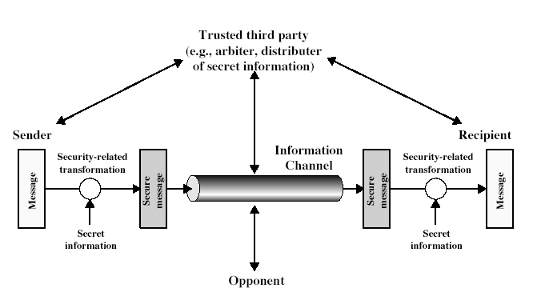
Model for Network Security
Notes:
In considering the place of encryption, its useful to use the following two models. The first models information flowing over an insecure communications channel, in the presence of possible opponents. Hence an appropriate security transform (encryption algorithm) can be used, with suitable keys, possibly negotiated using the presence of a trusted third party.

Slide 22
Model for Network Security
using this model requires us to:
  design a suitable algorithm for the security transformation
  generate the secret information (keys) used by the algorithm
  develop methods to distribute and share the secret information
  specify a protocol enabling the principals to use the transformation and secret information for a security service

Slide 23
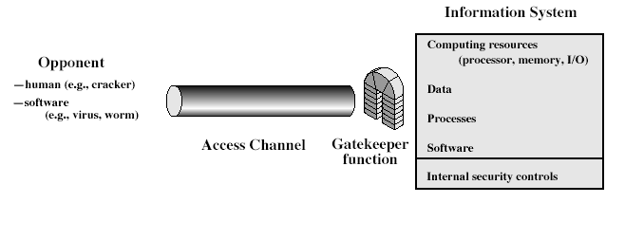
Model for Network Access Security
Notes:
The second model is concerned with controlled access to information or resources on a computer system, in the presence of possible opponents. Here appropriate controls are needed on the access and within the system, to provide suitable security. Some cryptographic techniques are useful here also.

Slide 24
Model for Network Access Security
using this model requires us to:
  select appropriate gatekeeper functions to identify users
  implement security controls to ensure only authorised users access designated information or resources
trusted computer systems can be used to implement this model

Slide 25
Summary
have considered:
  computer, network, internet security def’s
  security services, mechanisms, attacks
  X.800 standard
  models for network (access) security

